Slide 1

Capstone Project
Digital Vidya
Machine Learning
Predictive Modeling

Slide 2
Model Building
Problem
Statement
To predict whether a loan will default or not
What is the probability that a particular individual would be defaulter?
Solution
Build a predictive model using Machine Learning Technique
Predict the class of Loan Defaulter
Determine the Probability of Loan Defaulter

Slide 3
Model Building
The Following steps one should follow during Model Building
Model Creation
Data
Cleaning
Missing Value Treatment
Near-Zero Variance Variable Reduction
Random Forest
Neural Networks
Support Vector Machine
Naïve Bayes
Logistic Regression
Exploratory
Data
Analysis
Uni-Variate Analysis
Correlation Analysis
Data
Feature Engineering
Data
Balancing
Model Validation
Up-Sampling
Down-
Sampling
In Particular
Summarization of Data
Missing Value Treatment
Univariate Analysis / Capping / Outlier Analysis
Derive Variable Creation
Dimensionality Reduction
Iteration of the Model
Validation
Prediction on production environment

Slide 4
Solution in R
R Code
Data
Out of four models, Random Forest is giving better result with accuracy 82% on validation data.

Slide 5
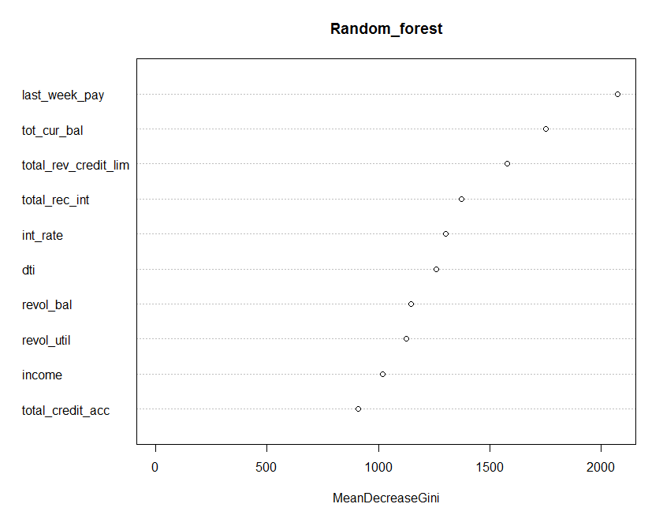
Solution in R Variable Reduction or Variable Importance using Random Forest
Variables | MeanDecreaseGini
last_week_pay | 1632.052665
tot_cur_bal | 1196.012306
total_rev_credit_lim | 1049.149743
total_rec_int | 870.7488581
dti | 857.2579695
int_rate | 791.8454674
revol_util | 747.9285002
revol_bal | 744.4062639
income | 671.4173593
total_credit_acc | 641.3760167

Slide 6
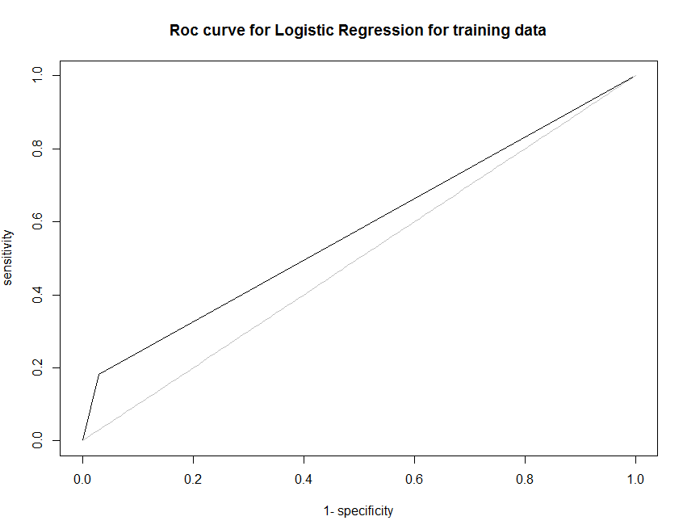
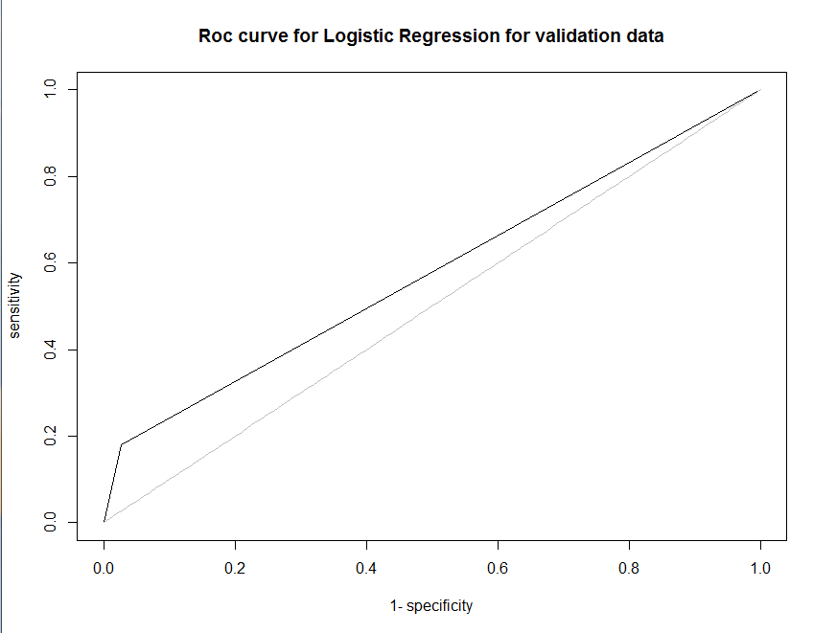
Solution in R
Logistics Regression Output
Training Data
Validation Data
Predicted | Reference
 | 0 | 1
0 | 27533 | 7269
1 | 850 | 1619
Predicted | Reference
 | 0 | 1
0 | 11841 | 3119
1 | 323 | 689
Accuracy | 78%
Sensitivity | 97%
Specificity | 18%
Pos Pred Value | 79%
Neg Pred Value | 66%
Area Under Curve | 58%
Positive Class | 0
Accuracy | 78%
Sensitivity | 97%
Specificity | 18%
Pos Pred Value | 79%
Neg Pred Value | 68%
Area Under Curve | 58%
Positive Class | 0

Slide 7
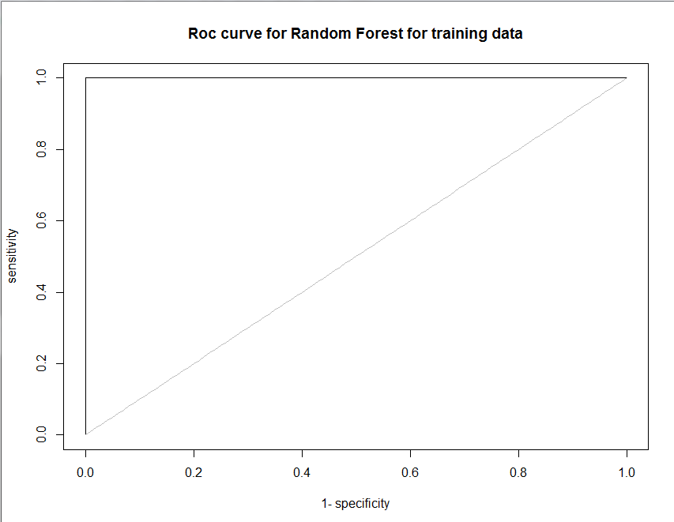
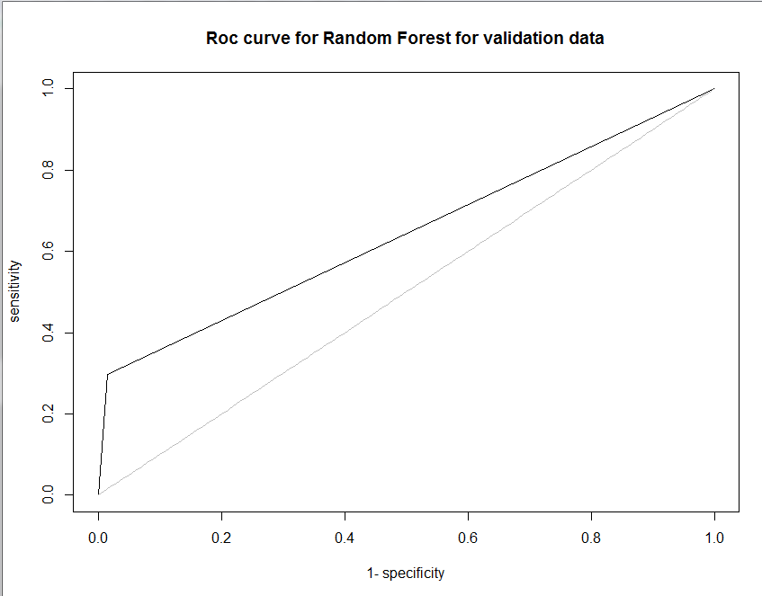
Solution in R
Random Forest Output
Training Data
Validation Data
Predicted | Reference
 | 0 | 1
0 | 28383 | 0
1 | 0 | 8888
Predicted | Reference
 | 0 | 1
0 | 11973 | 2674
1 | 191 | 1134
Accuracy | 100%
Sensitivity | 100%
Specificity | 100%
Pos Pred Value | 100%
Neg Pred Value | 100%
Area Under Curve | 100%
Positive Class | 0
Accuracy | 82%
Sensitivity | 98%
Specificity | 30%
Pos Pred Value | 82%
Neg Pred Value | 86%
Area Under Curve | 64%
Positive Class | 0

Slide 8
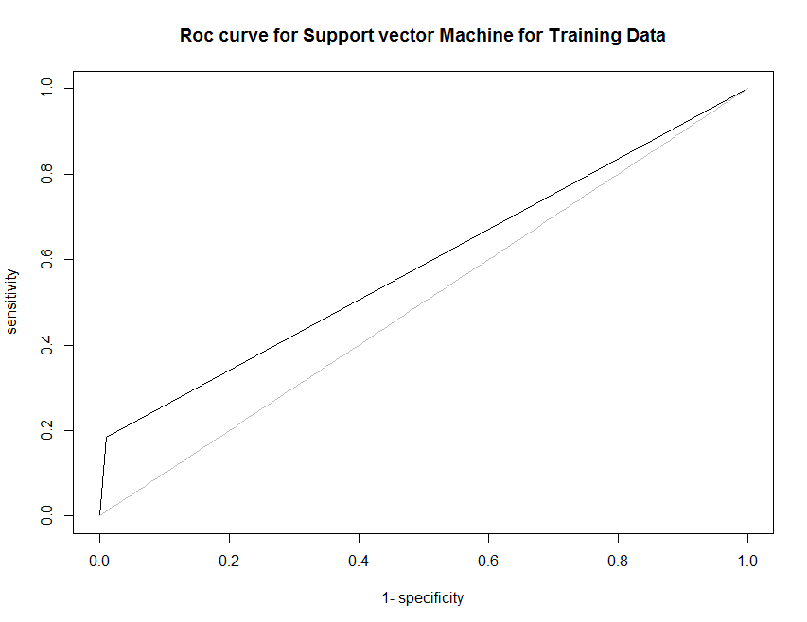
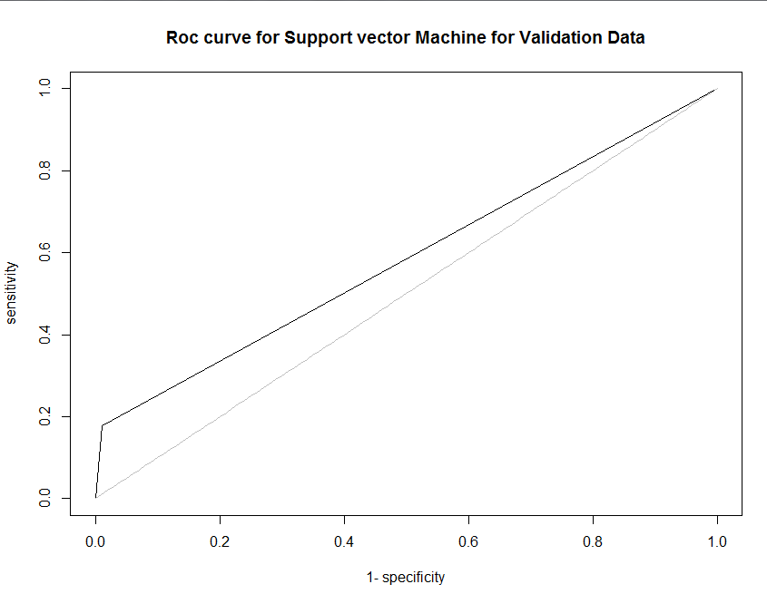
Solution in R
Support Vector Machine Output
Training Data
Validation Data
Predicted | Reference
 | 0 | 1
0 | 28095 | 7245
1 | 288 | 1643
Predicted | Reference
 | 0 | 1
0 | 12025 | 3129
1 | 139 | 679
Accuracy | 80%
Sensitivity | 99%
Specificity | 18%
Pos Pred Value | 80%
Neg Pred Value | 85%
Area Under Curve | 59%
Positive Class | 0
Accuracy | 80%
Sensitivity | 99%
Specificity | 18%
Pos Pred Value | 79%
Neg Pred Value | 83%
Area Under Curve | 58%
Positive Class | 0

Slide 9
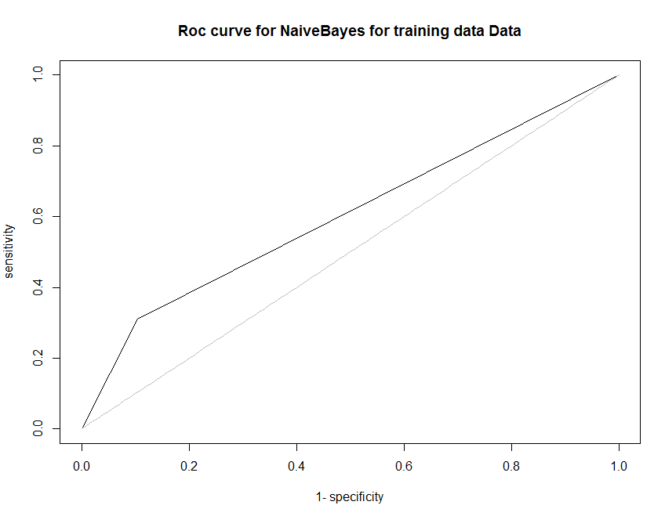
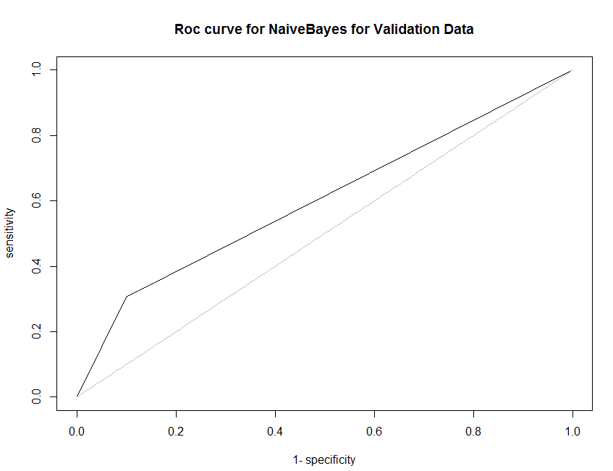
Solution in R
NaiveBayes Output
Training Data
Validation Data
Predicted | Reference
 | 0 | 1
0 | 25428 | 6135
1 | 2955 | 2753
Predicted | Reference
 | 0 | 1
0 | 10951 | 2645
1 | 1213 | 1163
Accuracy | 76%
Sensitivity | 90%
Specificity | 31%
Pos Pred Value | 81%
Neg Pred Value | 48%
Area Under Curve | 60%
Positive Class | 0
Accuracy | 76%
Sensitivity | 90%
Specificity | 31%
Pos Pred Value | 81%
Neg Pred Value | 49%
Area Under Curve | 60%
Positive Class | 0

Slide 10
Solution in Python

